Slide 1
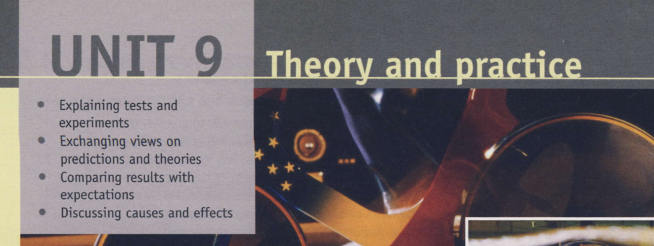

Notes:
You will find the following vocabulary useful in this section. because of ..., cause ... to ..., consequently ..., due to ..., owing to ..., result in ..., as a result of ...

Slide 2
Discussing causes and effects (pages 76 and 77) Having focused on predictions and theories (from discussions before tests and experiments take place) and comparing results with expectations (discussing how tests turned out), we now move on to discussing the reasons for the results of tests, by looking at the language used to relate to causes and effects. This is clearly important language in many aspects of engineering, from developing new devices and technologies to trouble-shooting existing devices and installations

Slide 3
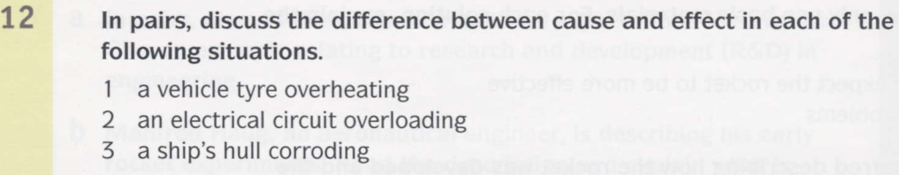
Possible causes: the tyre is inadequately inflated or punctured Possible effects: the tyre could blow out (explode) / the tyre will wear rapidly / become damaged
Possible causes: a surge in the power supply, too much power being demanded, a short circuit Possible effect: a circuit breaker being triggered, overheating and damage to conductors and components
3. Possible cause: there is inadequate paint cover to protect the hull Possible effect: the hull will degrade rapidly / could fail

Slide 4

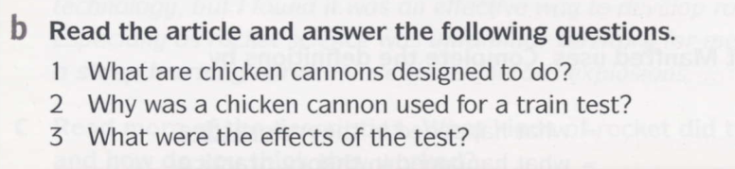
A mistake with a chicken gun has made clever, technical people look like fools
To fire dead chickens in order to test aircraft engines and windshields for their resistance to bird strikes
Because it was a high-speed train and bird strikes were a potential danger
The chicken broke through both the windshield and the back of the driver’s compartment.

Slide 5
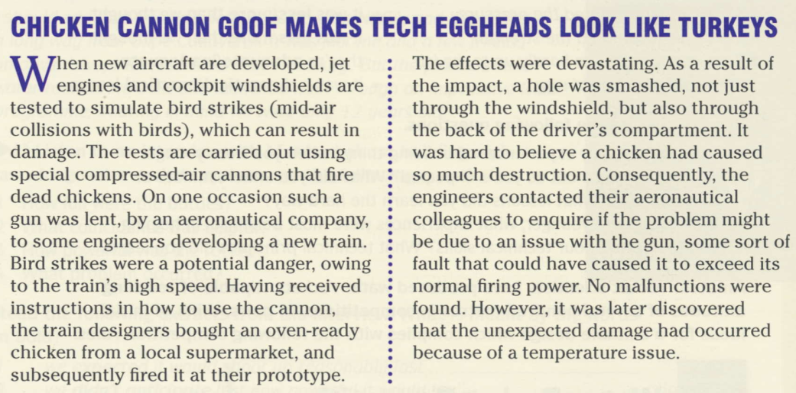

Slide 6
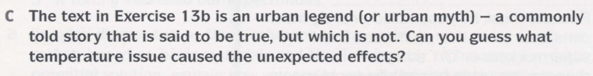
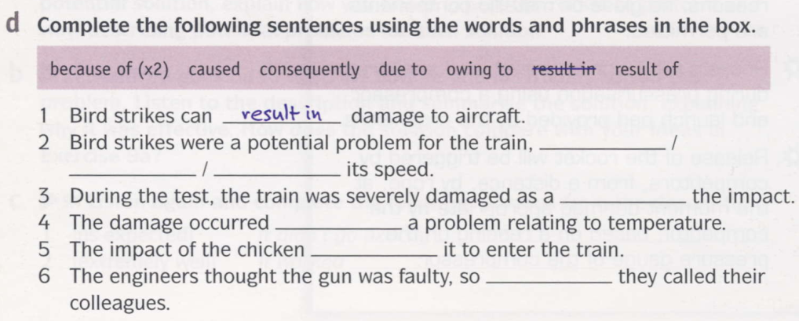
Answer: They used a frozen chicken.
because of
due to; owing to
result of
because of
caused
consequently
Notes:
2 because of; due to; owing to
3 result of
4 because of
5 caused 6 consequently

Slide 7
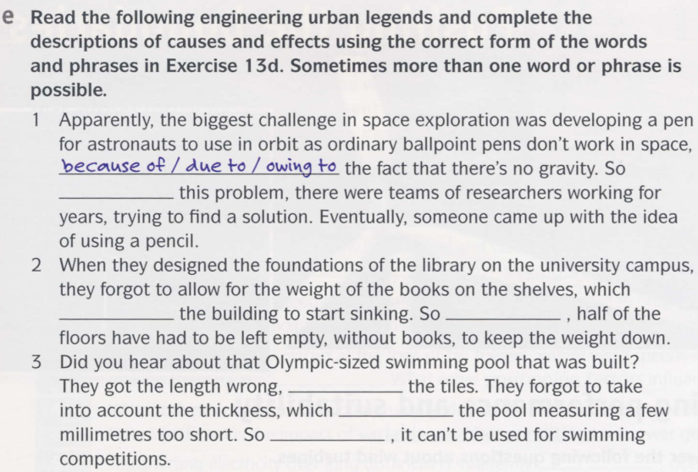
because of
caused
consequently
because of
due to
consequently
Notes:
1 because of / due to / owing to 2 caused; consequently 3 because of / due to / owing to; resulted in; consequently

Slide 8
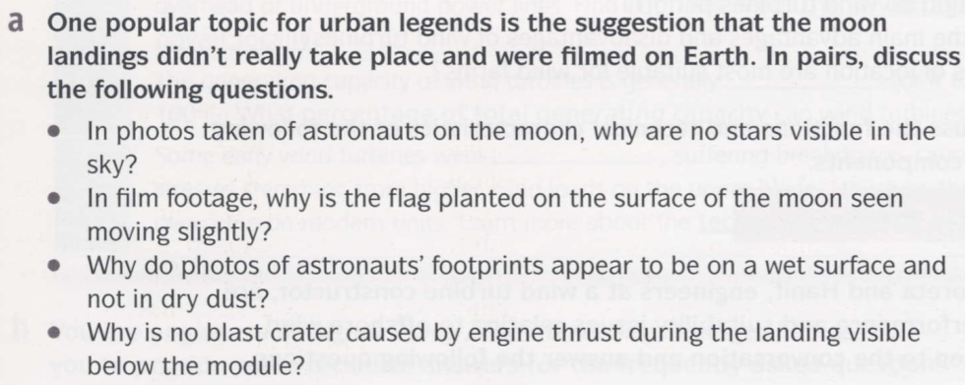

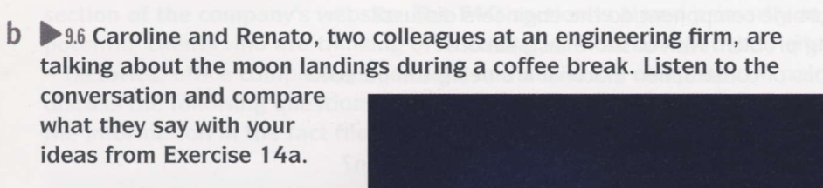
Notes:
Answers See audioscript 9.6 on page 94

Slide 9
